Slide 1


Prof-check
Web development project
NAME – UDAY BOLLA
ROLL NO – 22CS3024

Slide 2
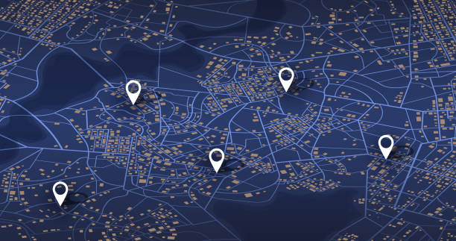
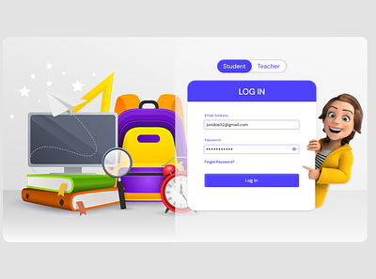
PROF-CHECK USE?
“PROF-CHECK” allows students to check whether the professer is present in the cabin or not and can also track the location of the required lecturer
Key components of the website –
1. Login Page :
Consists login options for proferssers and students separately
Navigation: Register, Login, About, Contact
2. Professor Login page :
Allows Professors to submit whether present in cabin or not
Allows to upload their live Location

Slide 3
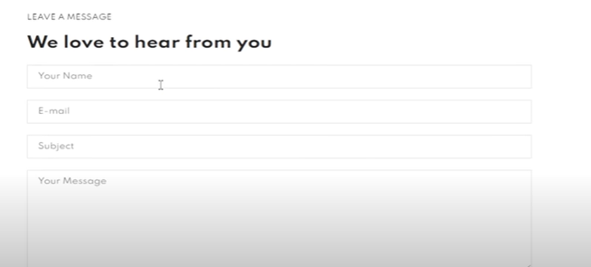
3. Student login page :
Allows students to select the required Professor and know whether present in cabin or not
In case of an emergency to meet the professor students can also find an option to get the location of the professor
4. Feedback Page :
The feedback page allows users to share their thoughts, enhancing the overall website experience.
Feedback Form: Users can provide comments, suggestions, and ratings.

Slide 4

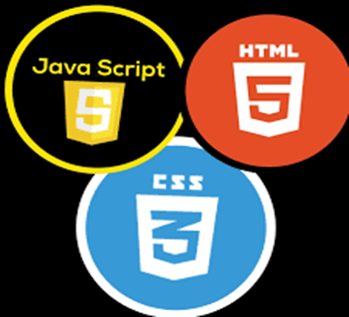
Technology, Benefits…?
Technologies Used:
HTML
CSS
Java Script
Node.js
API software
Features:
Allows students to not to go and wait outside the professor cabin
In case of an emergency situation for a student to meet a professor it allows to get the live location of the professor
Professors no need to worry about privacy issues, live location will only be visible to students only inside the campus premises
And also professors live location will be shared if they are only inside the campus premises.

Slide 5

Thank You

